Slide 1
SHIP DETECTION ON HIGH-RESOLUTION REMOTE SENSING IMAGE VIA SCENE USING MASK R-CNN
[ A18 BATCH]
DOMAIN: DEEP LEARNING
TEAM MEMBERS:
Dharshini A(211417104051)
Hemamalini R(211417104085)
Jayashree V(211417104090)
GUIDE: Mrs M.Sangeetha,M.Tech.,

Slide 2
ABSTRACT
Ship detection methods based on deep learning have improved accuracy over traditional methods. The detection of inshore and offshore ships is a major task in both military and civilian fields. The dataset was trained and used to detect the presence of the ships in a given image. In the existing system, we use Deep Neural Network (DNN) and YoloV3, which reduces the accuracy due to false alarms caused by ship-like objects on land. In the proposed system, we use an end-to-end method, such as Scene Mask R-CNN, which is proposed to reduce the onshore false alarms. The scene mask extraction network (SMEN), which is a network branch for scene segmentation, is present in the detection framework. We will detect the presence of ships in the given image using Machine Learning and Deep Learning Algorithms. In our project ship identification and categorization will be done. It will categorize warship, container ship, etc. Deep Learning is a subfield of machine learning with algorithms based on artificial neural networks. We use Convolutional Neural Network in our project for training and detecting the ships in the given image. Ship detection plays a major role in marine traffics, transportation, fisheries dumping of pollutants, and illegal smuggling.

Slide 3
INTRODUCTION
Ship detection from remote sensing imagery has been a major application for maritime security. When talking about maritime security, we have to consider many things like traffic surveillance, protection against illegal fisheries, oil discharge control, and sea pollution monitoring. Automated Identification System (AIS) is very effective at monitoring ships which are legally required to install a VHF transponder but fail to detect those which are not and those which disconnect their transponder.
Another most common approach is the CFAR-constant false rate use to detect targets with threshold with pixel’s amplitude hence it is difficult to extract features. In addition, these methods are typically dependent on the statistical distribution of sea clutter, leading to poor robustness for new SAR imagery. For extraction of ship all they need is synthetic aperture radar (SAR) images or panchromatic images as they are of high resolution. Monitoring of ships from satellite images helps in timely and periodic checking for anonymous movements in their territory region. Though in real time application it is much more complex and computation should be done considering this real time factor while detection and recognition. Remote sensing plays a very important role in monitoring ships as it operates from some distance and has a wide monitoring range. At the same time the sea surface gives better valid information than the appearance of ship.

Slide 4
LITERATURE SURVEY

Slide 5
S.NO | TITLE | YEAR | AUTHOR | WORK | DRAWBACKS
1 2 3 4 | Adaptive Deconvolutional Networks For Mid And High Level Feature Learning Spatial Pyramid Pooling In Deep Convolutional Networks For Visual Recognition Very Deep Convolutional Networks for Large-Scale Image Recognition U-Net: Convolutional Networks for Biomedical Image Segmentation | 2016, International Conference on Computer Vision 2015, IEEE Transactions on Pattern Analysis and Machine Intelligence. 2015, computer Vision and Pattern Recognition (cs.CV) 2015, International Conference on Medical Image Computing and Computer-Assisted Intervention | D. Zeiler, Graham W. Taylor and Rob Fergus Kaiming He, Xiangyu Zhang, Shaoqing Ren, and Jian Sun Karen Simonyan_ & Andrew Zisserman Olaf Ronneberger, Philipp Fischer, and Thomas Brox | We present a hierarchical model that learns image decompositions via alternating layers of convolutional sparse coding and max pooling. Existing deep convolutional neural networks(CNNs)require a fixed-size(e.g.,224x224)input image .In this work ,we equip the network with another pooling strategy,”spatial pyramid pooling”, to eliminate the above requirement. In this work we investigate the effect of the convolutional network depth on its accuracy in the large-scale image recognition setting., which shows that a significant improvement on the prior-art configurations can be achieved by pushing the depth to 16-19 weight layers. In this paper, we present a network and training strategy that relies on the strong use of data augmentation to use the available annotated samples more efficiently. We show that such a network can be trained end-to-end from very few images and outperforms the prior best method (a sliding-window convolutional network) on the ISBI challenge for segmentation of neuronal structures in electron microscopic stacks. | While edges only vary in orientation and scale, larger-scale structures are more variable Convolutional layers do not require a fixed image size and can generate feature maps of any sizes. Oceanic SAR imagery is affected by different kinds of disturbances, such as speckle or marine discontinuity effects due to random changes in bathymetry and wind currents. Larger patches require more max-pooling layers that reduce the localization accuracy.

Slide 6
S.NO | TITLE | YEAR | AUTHOR | WORK | DRAWBACKS
5 6 7 8 | Segnet: A Deep Convolutional Encoder-Decoder Architecture for Image Segmentation Fully Convolutional Networks for Semantic Segmentation Object Detection with Deep Learning Faster R-CNN: Towards Real-Time Object Detection With Region Proposal Networks | 2016, IEEE Transactions on Pattern Analysis and Machine Intelligence. 2016, Proceedings of the IEEE Conference on Computer Vision and Pattern Recognition (CVPR) 2019, IEEE Transactions on Neural Networks and Learning Systems 2015,Computer Vision and Pattern Recognition | Vijay Badrinarayanan, Alex Kendall, Roberto Cipolla Evan Shelhamer_, Jonathan Long_, and Trevor Darrell Zhong-Qiu Zhao, Peng Zheng,, Shou-tao Xu, and Xindong Wu Shaoqing Ren_ Kaiming He Ross Girshick Jian Sun | We present a novel and practical deep fully convolutional neural network architecture for semantic pixel-wise segmentation termed SegNet. The up sampled maps are sparse and are then convolved with trainable filters to produce dense feature maps. We show that convolutional networks by themselves, trained end-to-end , pixels-to-pixels, exceed the state-of-the-art in semantic segmentation. Their performance easily stagnates by constructing complex ensembles that combine multiple low-level image features with high-level context from object detectors and scene classifiers. Finally, several promising directions and tasks are provided to serve as guidelines for future work in both object detection and relevant neural network-based learning systems. In this work, we introduce a Region Proposal Network (RPN) that shares full-image convolutional features with the detection network, thus enabling nearly cost-free region proposals. | The maximum of all the classifier responses in this sub tree becomes the classification score of the query image. Each pixel is labeled with the class of its enclosing object or region, but with shortcomings that this work addresses. Large variations in viewpoints, poses, occlusions and lighting conditions, it’s difficult to perfectly accomplish object detection. A novel dataset that combines many of the properties of both object detection and semantic scene labeling datasets

Slide 7
S.NO | TITLE | YEAR | AUTHOR | WORK | DRAWBACKS
9 10 | Deep Residual Learning for Image Recognition Selective Search for Object Recognition | 2016, IEEE Conference on Computer Vision and Pattern Recognition (CVPR) 2011, International Conference on Computer Vision | Kaiming He Xiangyu Zhang Shaoqing Ren Jian Sun Koen E. A. van de Sande, Jasper R. R. Uijlings, Theo Gevers, Arnold W. M. Smeulders | Deeper neural networks are more difficult to train. We explicitly reformulate the layers as learning residual functions with reference to the layer inputs, instead of learning unreferenced functions. For object recognition, the current state-of-the-art is based on exhaustive search. Our method is class-independent and is shown to cover 96.7% of all objects in the Pascal VOC 2007 test set using only 1,536 locations per image. | Up to now, ship detection in optical satellite images is still challenging with respect to clouds, waves, wake clutters, and the variability of ship sizes. Existing methods for general object detection cannot be applied to solve this problem effectively. Their relationship and contributions are extensively investigated and evaluated

Slide 8
PROBLEM STATEMENT
Ship detection and classification based on optical remote sensing images raise considerable attention in the sea surface remote sensing field. Basic feature extraction strategies and algorithms are analyzed associated with their performance and application in ship detection and classification. Based on the analysis, the remaining problems and future development trends are provided for ship detection and classification methods based on optical remote sensing images.
Ship detection is a crucial application for global monitoring for environment and security. It permits to monitor traffic, fisheries, and to associate ships with oil discharge. Typical discriminate parameters are ship lengths, speed, and radar cross section. A basic classification strategy is proposed.
In consideration of several challenges mentioned above, we believe that a practical ship detection Method should meet two requirements: it should be robust to the interference of the high variability of targets and background clutter such as waves, islands, clouds, and so forth. Of equal importance, with the purpose of the engineering applications, it should have lower calculation complexity and satisfy the requirements of real-time processing.

Slide 9
TECHNOLOGY STACK
Software :
Operating System : Windows 7 and above (64-bit).
Software :Anaconda 3.7 (Jupiter Notebook IDE)
Python : 3.7
Hardware:
Hard disk : 500 GB and above.
Processor : i3 and above.
Ram : 4GB and above.

Slide 10
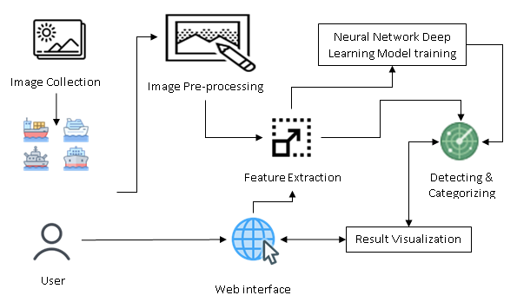
SYSTEM ARCHITECTURE

Slide 11
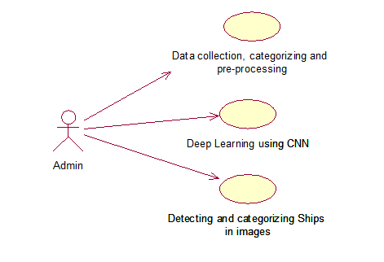
System Design – Use Case Diagram

Slide 12
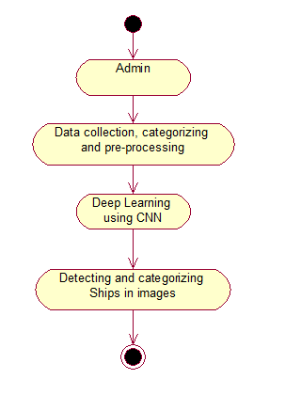
System Design – Activity Diagram

Slide 13
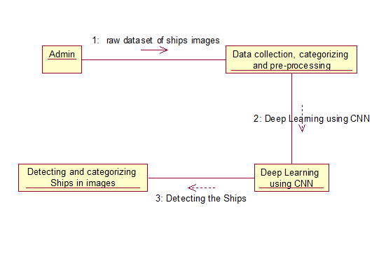
System Design – Collabration Diagram

Slide 14
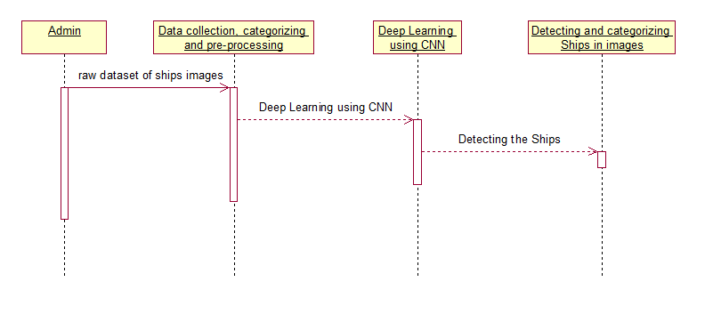
System Design –Sequence Diagram

Slide 15
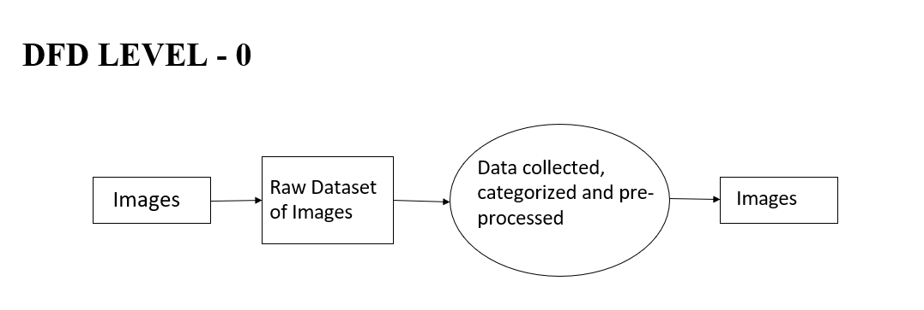
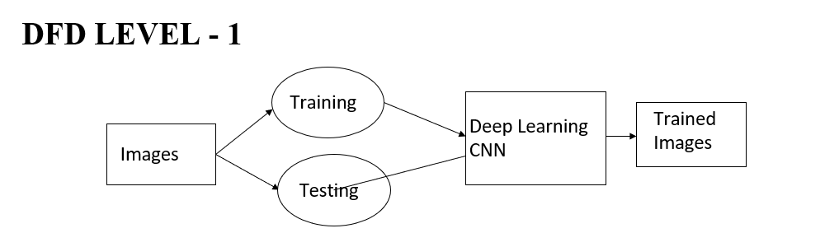
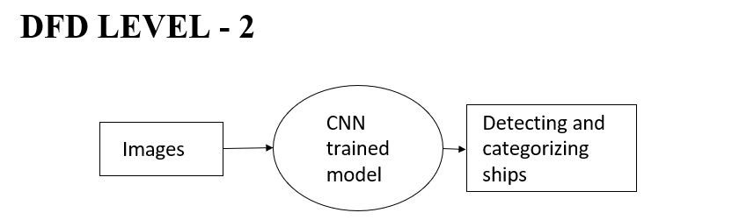
System Design – Data Flow Diagram

Slide 16
MODULES
Data collection, categorizing and pre-processing
Deep Learning using CNN
Detecting and categorizing Ships in images.

Slide 17
Data collection, categorizing and pre-processing
A High-Resolution Remote Sensing Image dataset was collected from data.gov. Many images do not contain ships, and those that do may contain multiple ships. Ships within and across images may differ in size (sometimes significantly) and be located in open sea, at docks, marinas, etc.
A raw dataset was collected with type of ships and images for each type of ships. Since we did not have more number of ships images classified based on the categories, we use python to web crawl images from internet. The web scraped images were stored in different folders. For this project we were using four categories. We have downloaded ship images for the following categories, Accommodation, Container, War and Cruise. Python with vast text processing and networking libraries is the best tool to write one-off web scrapper.

Slide 18
Deep Learning using CNN
Deep Learning is a subfield of machine learning concerned with algorithms inspired by the structure and function of the brain called artificial neural networks. Deep learning is a class of machine learning algorithms that use a cascade of multiple layers of nonlinear processing units for feature extraction and transformation. Each successive layer uses the output from the previous layer as input. We use convolutional Neural Network in our project for training and detecting the ships in the given image. We use multilayer neural network and each layer output is given as input to the next layer.

Slide 19
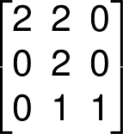
The Convolution Algorithm
The convolution is a kind of product operation of a filter — also called a kernel — with a matrix of image to extract from it some pre-determined characteristics. Literally-speaking, we use a convolution filter to “filter” the image to and display only what really matter to us. The considered image is a matrix, the filters used are also matrices, generally 3x3 or 5x5. Let’s see how convolution works with the following kernel,
The 6x6px matrix represents an image. At the beginning, the convolution kernel, here the 3x3 matrix is positioned on the top-left corner of the matrix image, the kernel then covers a part of this matrix image, we then make a product element by element (element-wise) of the two overlapping blocks we eventually sum these products and the final result corresponds to a pixel of the output image.

Slide 20
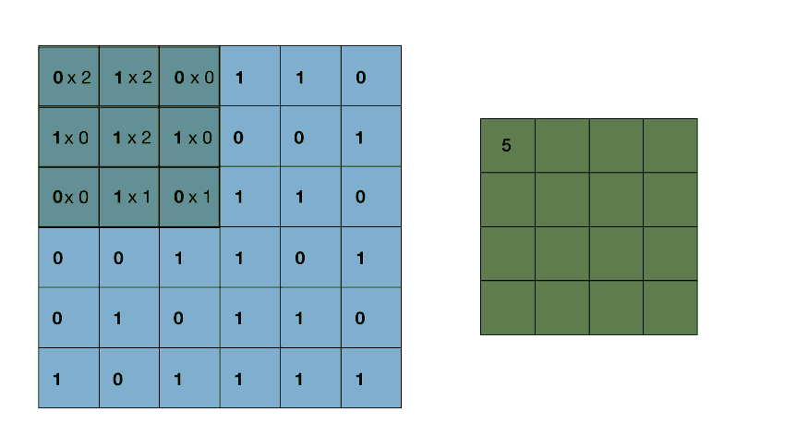
Then, we move the convolution kernel from horizontally to the right by one pixel, we make a new element-wise product then added up to get a new coefficient of the output image.
Once at the end of a line, the kernel makes a vertical stride down and starts again from the left, we iterate likewise until the kernel has covered all the matrix image. It is important to note that the kernel always remains on the initial matrix, without overflowing.
For sure, we cannot use any filter, the coefficients of our kernel will depend on the features we want the filter to highlight. Let’s see the result of a convolution with some well-known filters.

Slide 21
Detecting and categorizing Ships in images
In this work required to locate ships in images, and put an aligned bounding box segment around the ships you locate.
The CNN trained model is used to detect the availability and the category of the ship in the given image. When the user inputs the images to for detection, the prediction method in the trained model is used to detect the presence of the ship, and also the category of the ship. A new image file is created with the category written on top of the actual image.

Slide 22
Mask-RCNN
Mask RCNN is a deep neural network aimed to solve instance segmentation problem in machine learning or computer vision
Mask R-CNN uses anchor boxes to detect multiple objects, objects of different scales, and overlapping objects in an image. This improves the speed and efficiency for object detection. Anchor boxes are a set of predefined bounding boxes of a certain height and width.
Mask R-CNN is selected for this project because it can generate high-quality segmentation mask for each object. Its mask prediction branche is added in parallel to Faster R-CNN's bounding box and image class prediction.

Slide 23
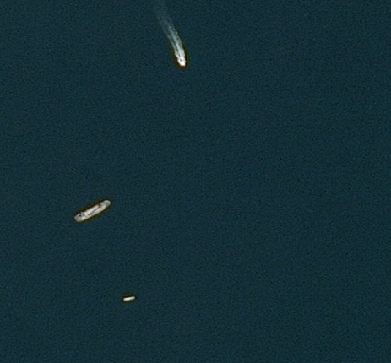
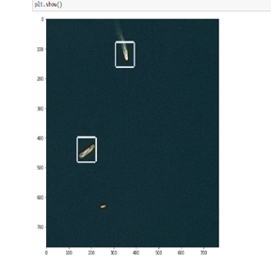
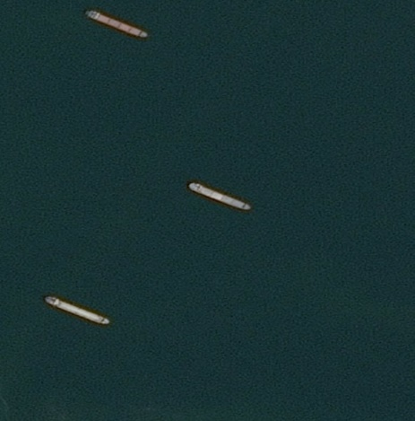
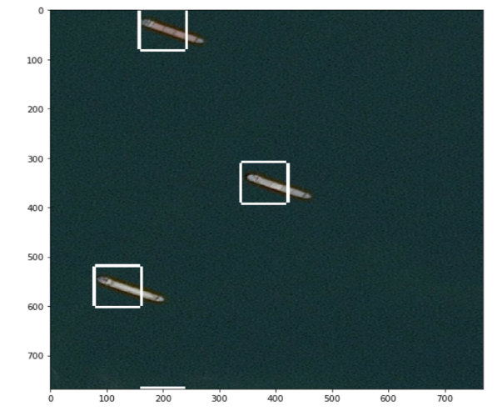

TEST CASES AND REPORT
DETECTION OF SHIPS
S.NO | INPUT | EXPECTED OUTPUT | ACTUAL OUTPUT | RESULT
1 |  |  |  | PASSED
2 |  |  |  | PASSED

Slide 24
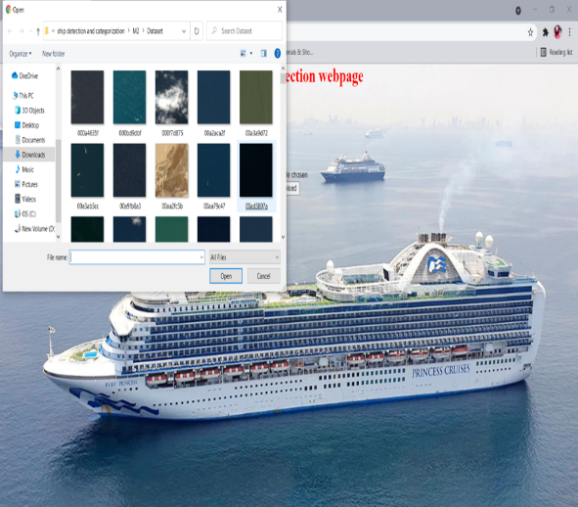
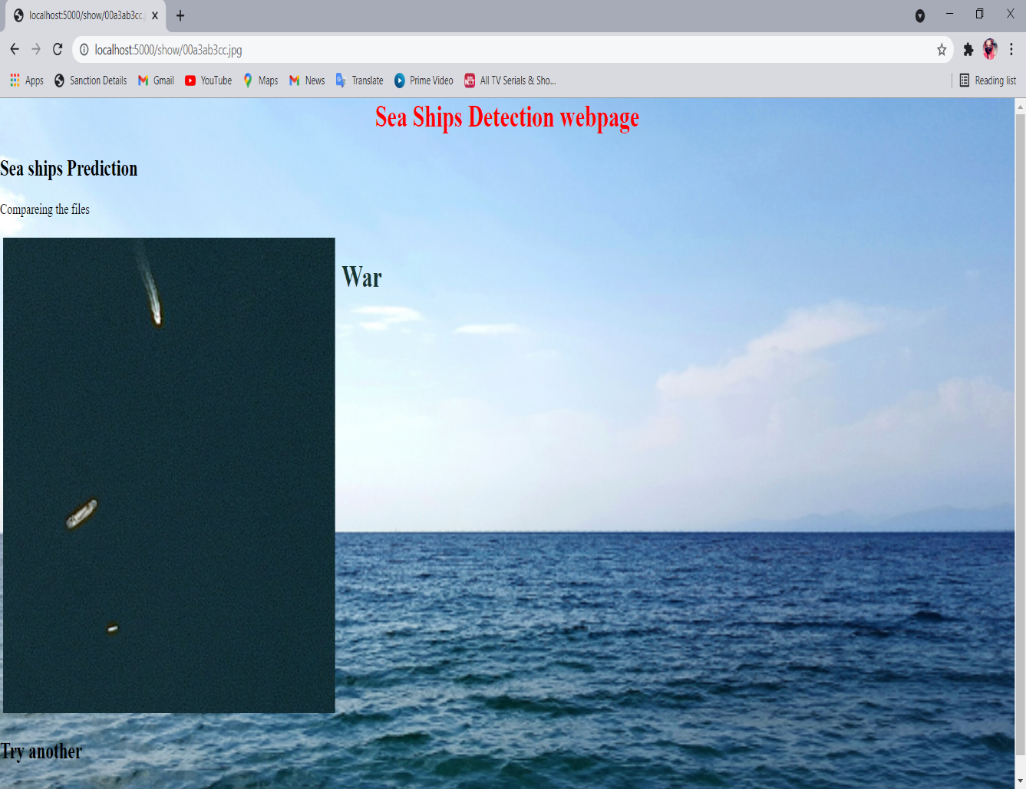
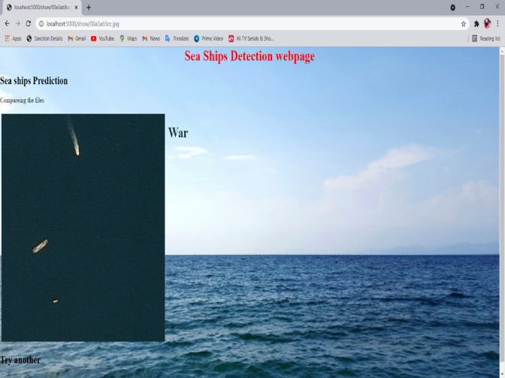

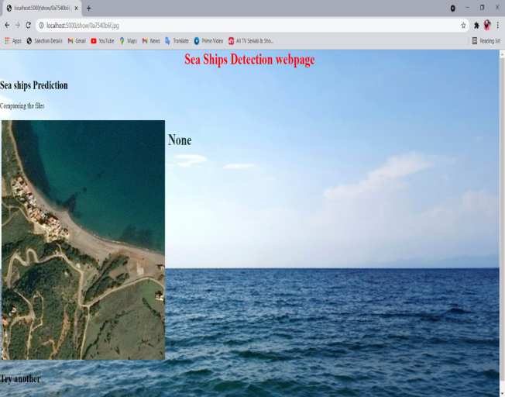

CATEGORIZATION OF SHIPS
S.NO | INPUT | EXPECTED OUTPUT | ACTUAL OUTPUT | RESULT
1 |  |  |  | PASSED
2 |  |  |  | PASSED

Slide 25
PERFORMANCE ANALYSIS
Mask R-CNN achieves 92.3% of accuracy rate by solving imbalanced problems, which yields improvement over Yolo v3 and Rotational Libra R-CNN. It achieves an detection rate of 30.3 frames. Our method has the best accuracy which is higher than R2CNN by 7.35%. A key reason is that our method achieves more discriminative features and better convergence. In addition, for the arbitrarily oriented slim ship, the rotational region detection branch is designed to eliminate the redundant background.

Slide 26
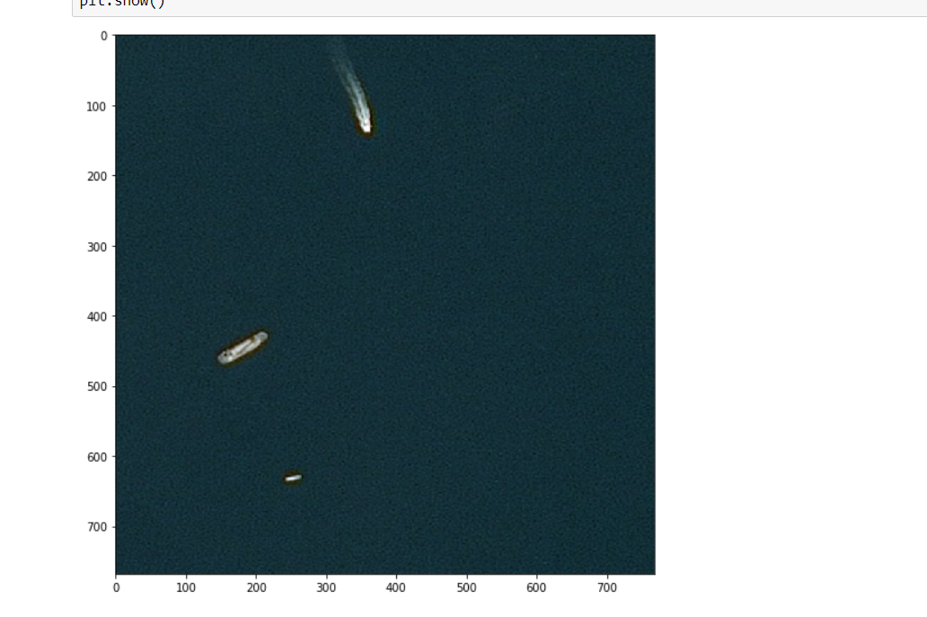
SCREENSHOTS-DATASETS
STEP 1:
STEP 2:

Slide 27
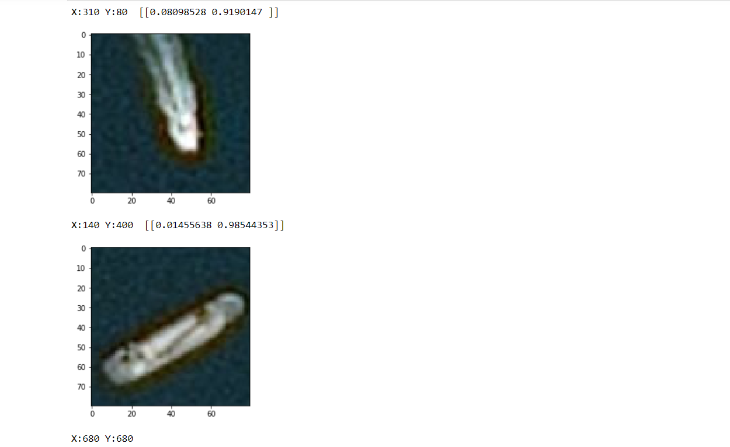
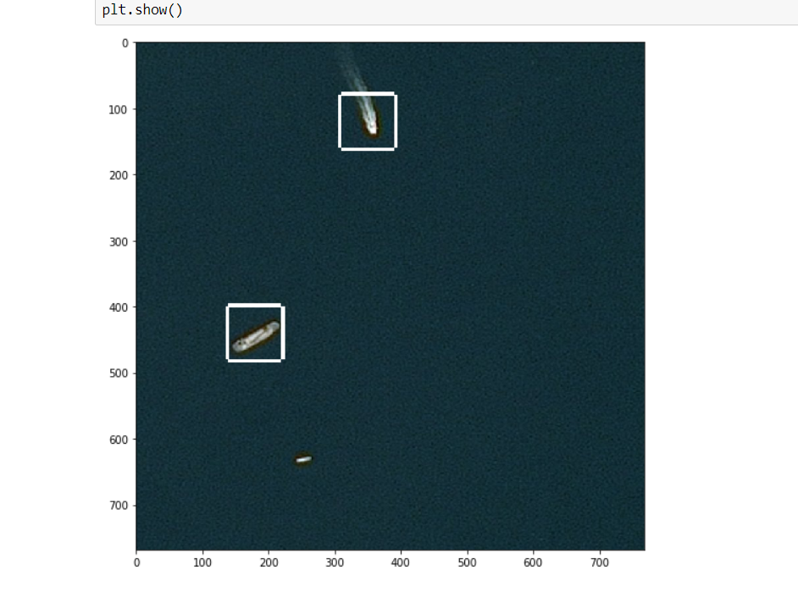
STEP 3:
STEP 4:

Slide 28
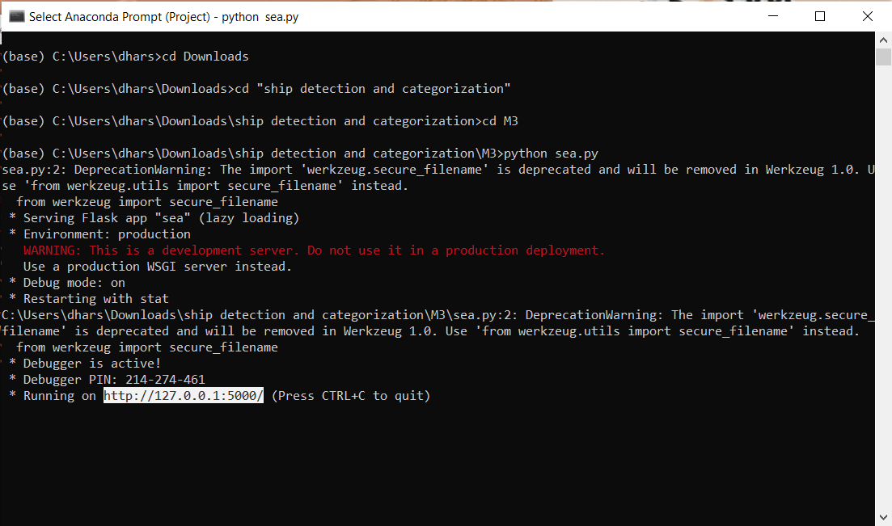
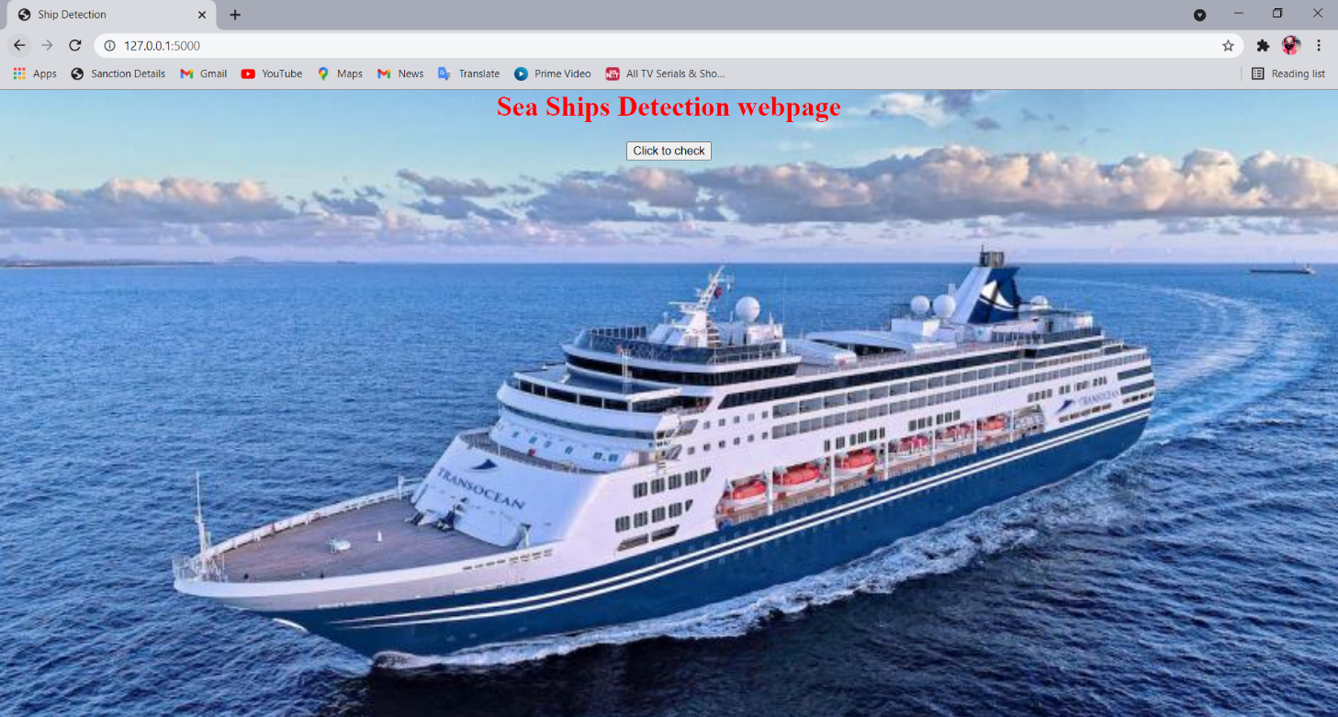
STEP 5:
STEP 6:

Slide 29
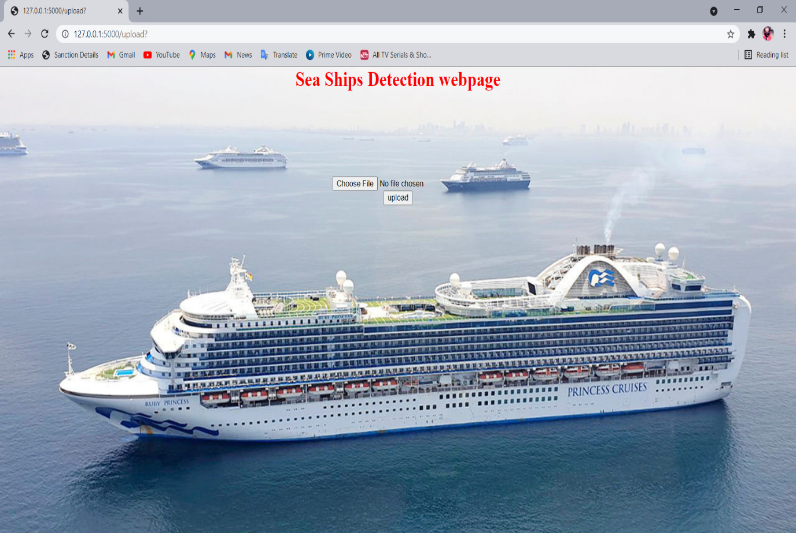

STEP 7:
STEP 8:

Slide 30

STEP 9:
STEP 10:

Slide 31
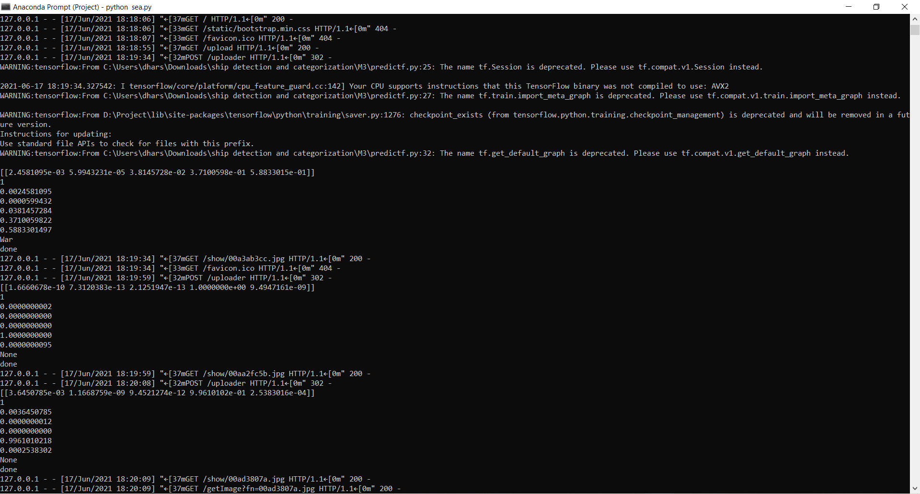
STEP 11:

Slide 32
CONCLUSION AND FUTURE ENHANCEMENT
In this article, we investigate the constraints of thick dissemination and various sizes. Therefore, we propose Mask R-CNN, a mask R-CNN for transport discovery. BFP module and IOU-BS module are presented with the inspiration of separating discriminative highlights to conquer the effect of various sizes. Moreover, the rotational district location with adjusted L1 misfortune is at long last proposed to be hearty against the effect of thick appropriation. Our strategy can acquire reliable upgrades in exactness and perception. What's more, broad tests on the DOTA show that the proposed technique can acquire 3.43% than R2CNN and 4.09% than mask R-CNN. Alongside transport recognizable proof, we propose boat characterization framework dependent on the structure and class of boats. The proposed framework would distinguish a boat, yet would likewise characterize it as a warship, load boat and journey transport. It would decrease the quantity of bogus cautions on the coast. We are proposing alongside transport location, a boat order dependent on the kind and classification of the boats. The proposed framework won't just distinguish a transport yet additionally arrange as war transport, holder transport and so on It will decrease the on shore bogus alerts.

Slide 33
REFERENCE
[1] D. Zeiler, Graham W. Taylor and Rob Fergus,”Adaptive Deconvolutional Networks For Mid And High Level
Feature,”International Conference on Computer Vision, 2016
[2] Kaiming He, Xiangyu Zhang, Shaoqing Ren, and Jian Sun,”Spatial Pyramid Pooling In Deep Convolutional Networks For Visual Recognition,”IEEE Transactions on Pattern Analysis and Machine Intelligence, 23 April 2015
[3] Karen Simonyan & Andrew Zisserman,” Very Deep Convolutional Networks for Large-Scale Image Recognition,” Computer Vision and Pattern Recognition (cs.CV) ,2015
[4] Olaf Ronneberger, Philipp Fischer, and Thomas Brox,” U-Net: Convolutional Networks for Biomedical Image Segmentation,” International Conference on Medical Image Computing and Computer-Assisted Intervention,18 May 2015
[5] Vijay Badrinarayanan, Alex Kendall, Roberto Cipolla,” Segnet: A Deep Convolutional Encoder-Decoder
Architecture for Image Segmentation,” IEEE Transactions on Pattern Analysis and Machine Intelligence, 10 Oct 2016

Slide 34
[6] Evan Shelhamer_, Jonathan Long_, and Trevor Darrell” Fully Convolutional Networks for Semantic Segmentation,” Proceedings of the IEEE Conference on Computer Vision and Pattern Recognition (CVPR),”20 May 2016
[7] Zhong-Qiu Zhao, Peng Zheng, Shou-tao Xu, and Xindong Wu ”Object Detection with Deep Learning,” IEEE Transactions on Neural Networks and Learning Systems,16 Apr 2019
[8] Shaoqing Ren_ Kaiming He Ross Girshick Jian Sun,’’Faster R-CNN: Towards Real-Time Object Detection
With Region Proposal Networks,’’Computer Vision and Pattern Recognition,2019
[9] Kaiming He Xiangyu Zhang Shaoqing Ren Jian Sun,’’Deep Residual Learning for Image Recognition,”IEEE Conference on Computer Vision and Pattern Recognition (CVPR),2015
[10] Koen E. A. van de Sande, Jasper R. R. Uijlings, Theo Gevers, Arnold W. M. Smeulders,’’Selective Searchfor Object Recognition,’’International Conference on Computer Vision,2012

Slide 35
PUBLICATION DETAILS
This project was published as a paper in Journal of Emerging Technologies and Innovative Research on 25.04.2021 by Hemamalini R, Dharshini A, Jayashree V.
Published issue: ISSN:2349-5162,Vol 8 issue 4, April 2021
DOI Details: https://www.jetir.org/view?paper=JETIRES06024

